Slide 1

Anti Kidnapping System
Supervised By:
Dr. Ahmed Hamza (Lecture at faculty of Computer and Information Technology Egyptian E-Learning University)
Eng. Mostafa Abdelbari (Teacher Assistant, Department of Information Technology Egyptian E-Learning University)

Slide 2

Prepared By:
Abanoub Sobhy Dous Dawes
Peter Mayez Botros Farag
Ebram Ehab Fowaz Melk
Ahmed Medhat Mohameden Abd Elatif
Youssef Mikhail Mounier Elyas
Marins Samir Helmy Eskander
Nada Mohamed Ahmed Hassan

Slide 3
Outline
Introduction
Problem Statement
Problem Solution
Hardware and Software Requirements
System Methodology
System Performance
Future Scope
Implementation
Experimental Results

Slide 4
Introduction

Slide 5

Introduction
An anti-kidnapping system is a comprehensive set of measures, technologies, and protocols designed to prevent, respond to, and mitigate the risks associated with kidnapping incidents.
These systems are increasingly vital in regions where kidnapping is a prevalent threat, whether for ransom, political leverage, or other criminal motivations.
such systems aim to protect individuals from the growing threat of kidnapping while ensuring their safety and security in diverse environments.

Slide 6
Problem Statement

Slide 7
Problem Statement
According to statistics, from 2019 to 2024, kidnapping are increasing, and the statistics reveal that the child helpiine received more than 2,264 reports of kidnappings.
There are many reasons for kidnapping children, whether to obtain ransom, political influence, or other crimes.
We are thinking about how we can reduce the number of child kidnappings while ensuring their safety and providing them with security.

Slide 8
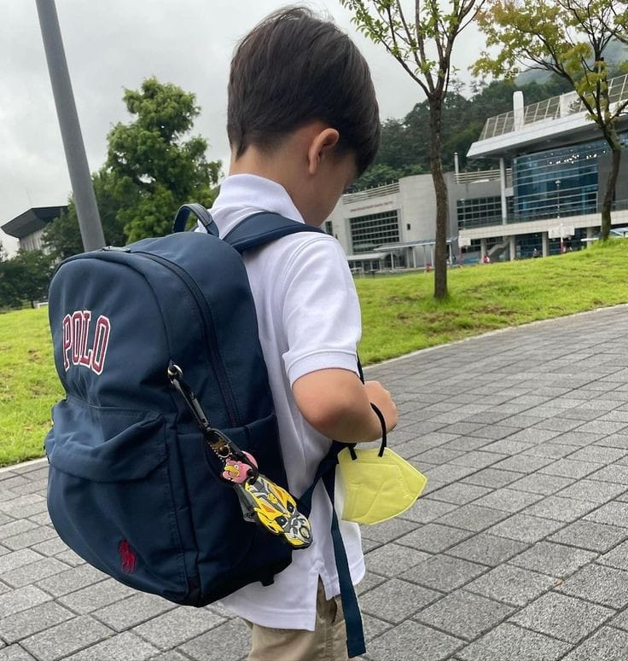


Problem Statement Cont ..

Slide 9

Problem Solution

Slide 10

Proposed Solution
“Anti Kidnapping system” is designed to track and monitor the location of a child to ensure their safety.
It typically involves GPS technology that allows parents or guardians to know the child’s whereabouts in real-time.
This system can provide alerts if the child leaves designated safe zones or if there are any unusual activities.

Slide 11
Hardware and Software Requirements

Slide 12
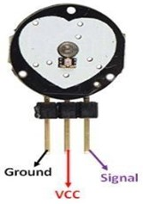
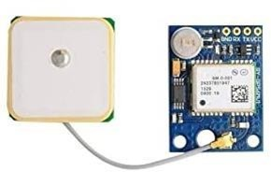
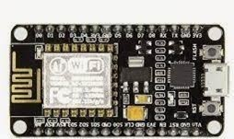
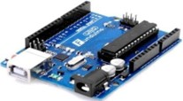
Hardware Requirements
Pulse Sensor
Node MCU ESP8266
NEO-6M GPS Module Pinout
Arduino Uno

Slide 13
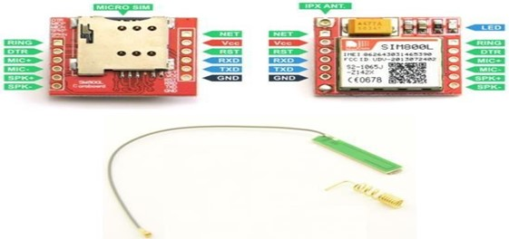
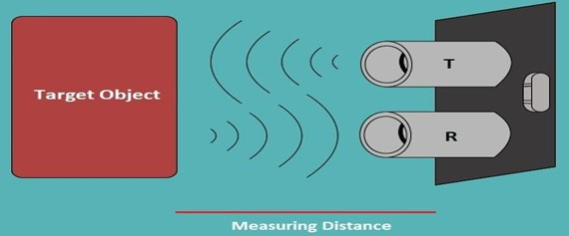
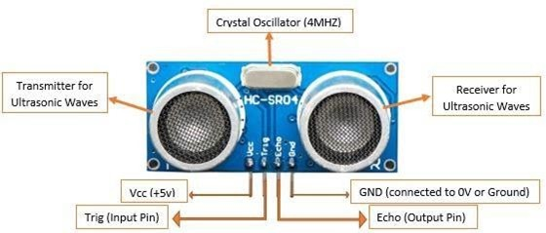
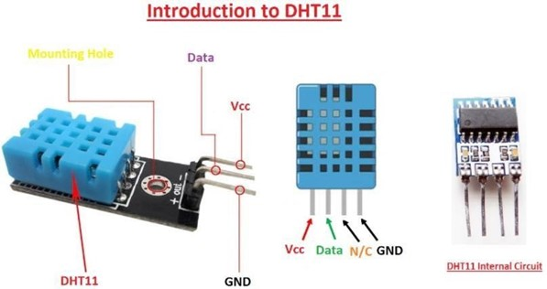
Hardware Requirements Cont ..
GSM SIM800L
HC-SR04 “Ultrasonic Sensor”
HC-SR04 model contain 4 pins
Pinout consists of 4 Pins in total

Slide 14
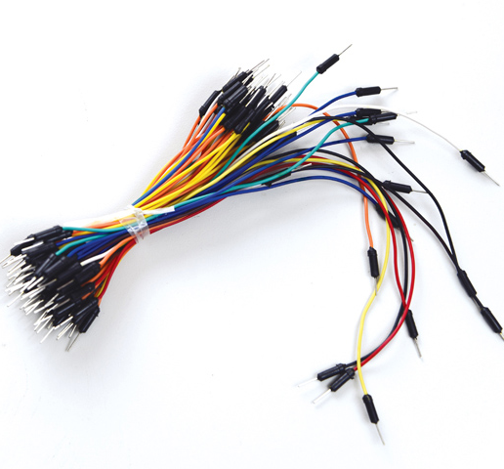
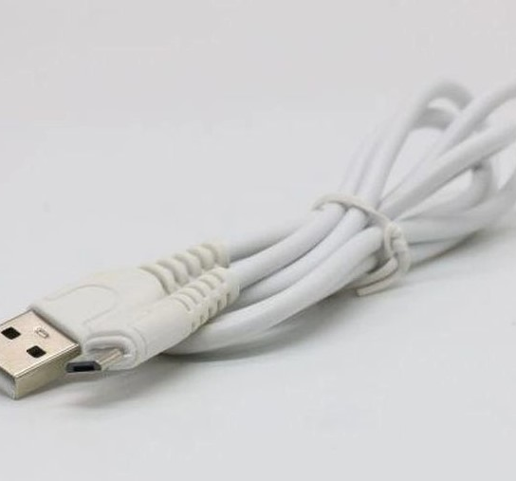
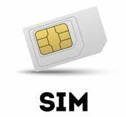
Hardware Requirements Cont ..
Jumper Wires
Micro USB cable
Micro SIM Card
(ETSALAT)

Slide 15
Software Requirements
flutter and dart
Core Flutter SDK and Essential Packages:
flutter: The core Flutter SDK.
cupertino_icons: Icons following the Cupertino design for iOS apps.
State Management:
bloc: Business Logic Component library for state management.
flutter_bloc: Integrates bloc with Flutter.
animated_conditional_builder: Provides widgets for conditional rendering with animations.
Local Storage:
shared_preferences: For storing simple data locally on the device.

Slide 16
Software Requimements
Networking:
http: For making HTTP requests.
dio: A powerful HTTP client for Dart, which supports interceptors, global configuration, and Form Data.
Geolocation and Maps:
geolocator: For accessing device location.
geocoding: For converting coordinates into addresses.
flutter_polyline_points: For drawing polylines on maps.
permission_handler: For handling permissions.
location: For getting location data.

Slide 17
Software Requirements
Firebase:
Firebase core: Core Firebase functionalities.
Firebase auth: Firebase Authentication.
Cloud firestore: Cloud Fire store for storing and syncing data.
Firebase storage: Firebase Cloud Storage.
Firebase database: Firebase Realtime Database.
UI Components:
fluttertoast: For displaying toast notifications.
Modal progress hudnsn: For showing a modal progress indicator.
Percent indicator: For displaying circular and linear percent indicators.
Awesome bottom bar: For creating customizable bottom navigation bars.

Slide 18
Software Requirements
Form and Validation:
email validator: For validating email addresses.
Image Handling:
Image picker: For picking images from the gallery or camera.
Localization:
intl: For internationalization and localization.
Development Tools:
Flutter test: For writing unit tests for Flutter apps.

Slide 19
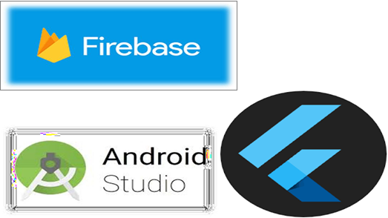
Software Requirements
IDE -> Android studio

Slide 20
System Methodology

Slide 21

System Methodology
we use a small control by Arduino and GSM module in which the system in listening case; if there is a message camming to GSM module send it to Arduino via serial ports and do some verification on the SMS:
If the SMS contain word “Location” read from the GPS device the coordination of latitude and longitude, and this data came from four or more satellites that’s around on the ground
in this case the GPS is fixed. After that in Arduino program part,
we create a message contain “form of SMS alarm” (GPS coordination with the link of google map) and reply to this information to the number phone what is send the message in the first via the GSM module..
If the SMS contain other word or in the case no message camming to GSM module
The system does not perform any response in this case and continues in the other parts of the general system.

Slide 22
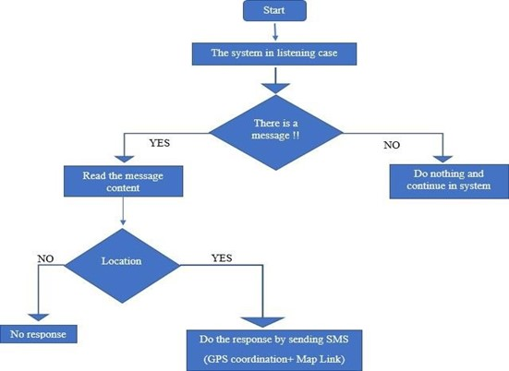
System Methodology

Slide 23
System Performance

Slide 24
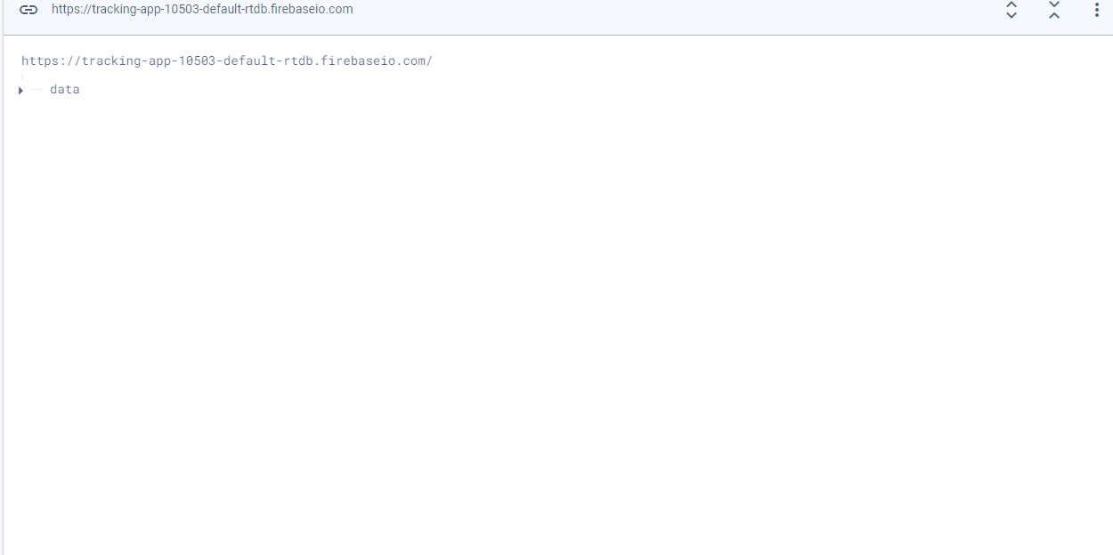
RealTime Database

Slide 25
Future Scope

Slide 26

Future Scope
Monitoring system of battery status ( charging & discharging ) using IOT
Replace GPS device by the use of SIM card network services to determine the location through the card network used in the GSM module
Processing and evaluating the acquired data using an artificial intelligence model to determine the situation in which the kid is
Minimize the size of the tracker and camera as much as possible

Slide 27
Hardware Implementation

Slide 28
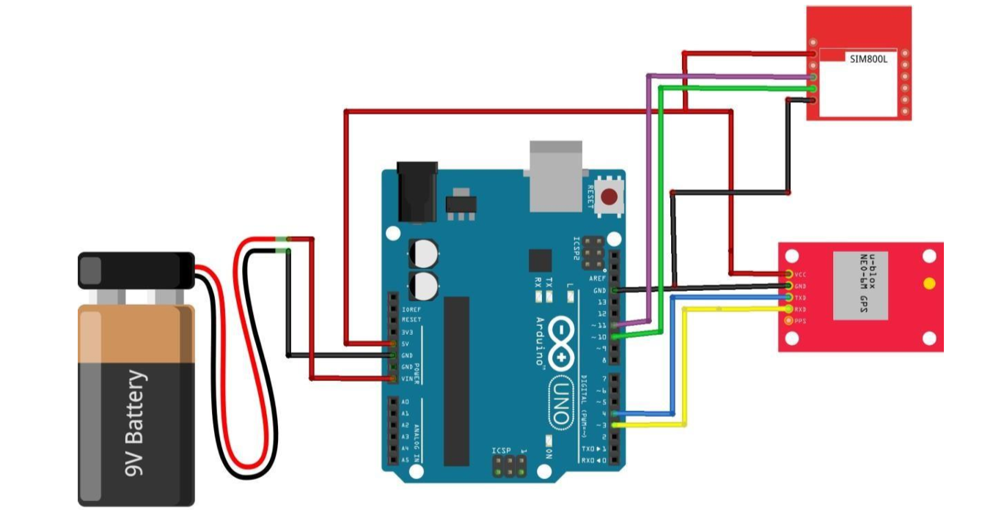
Hardware Implementation

Slide 29
Software Implementation

Slide 30
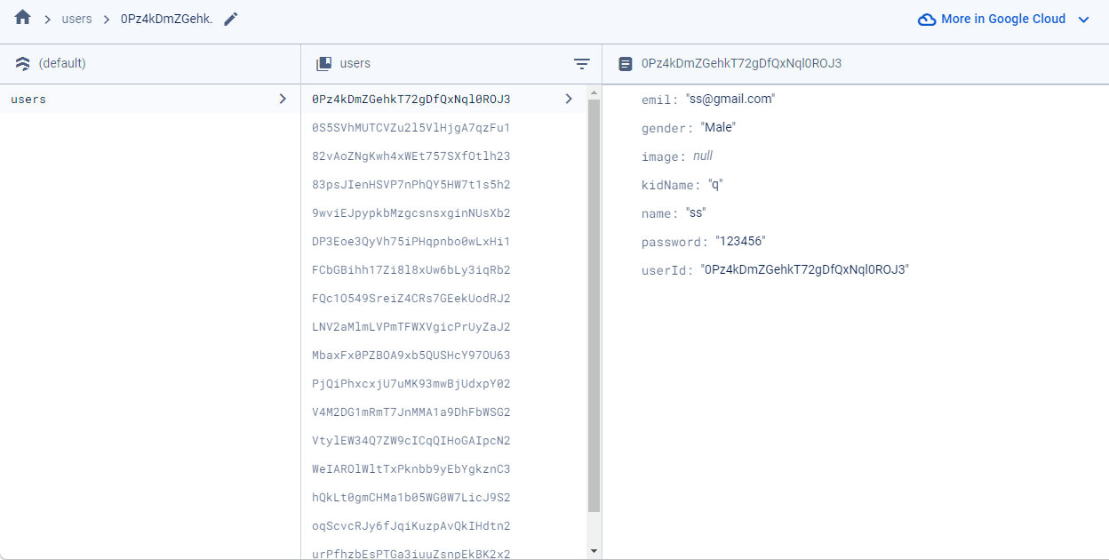
Firestore Batabase

Slide 31
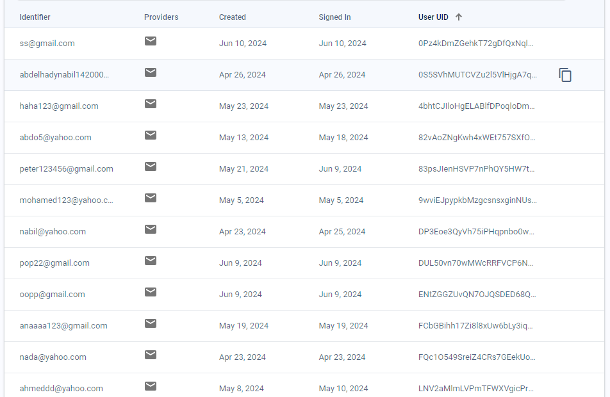
Authentication

Slide 32
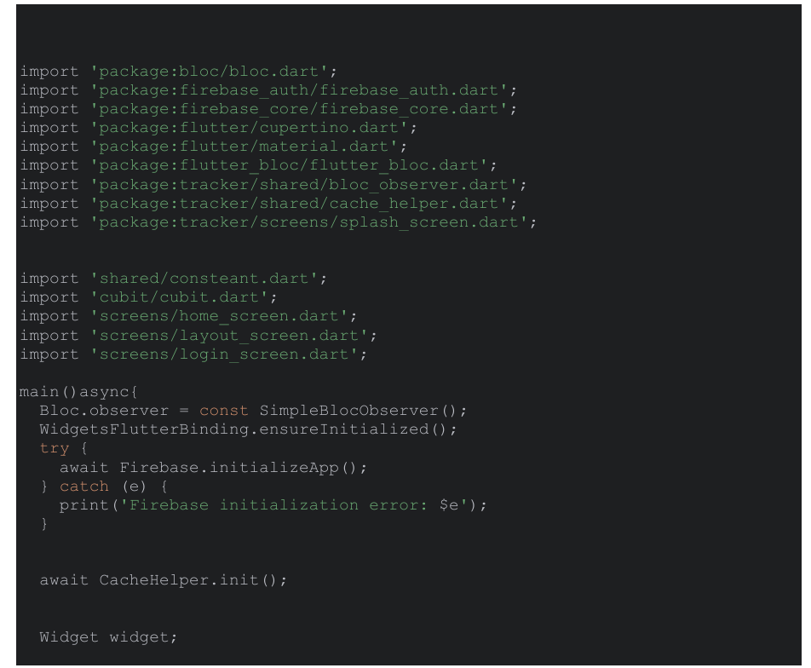
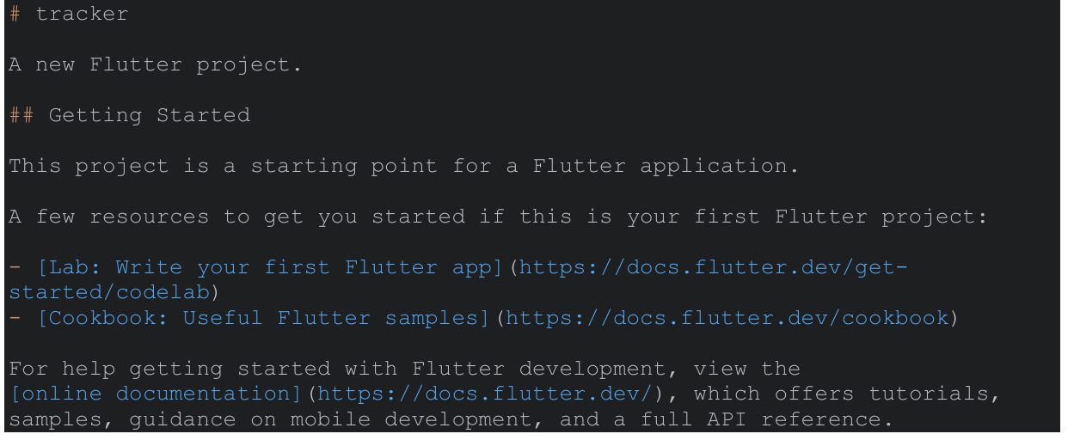
Software Implementation Cont ..
Snipped Shot of Code
Snipped Shot of Code

Slide 33
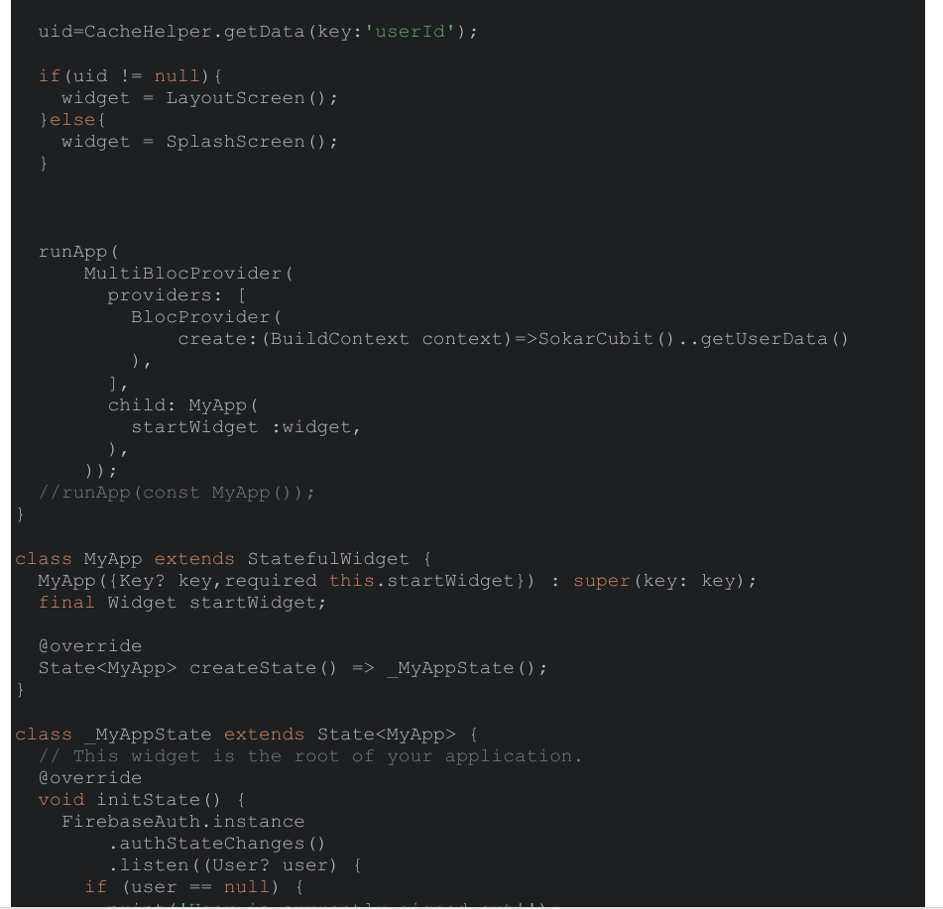
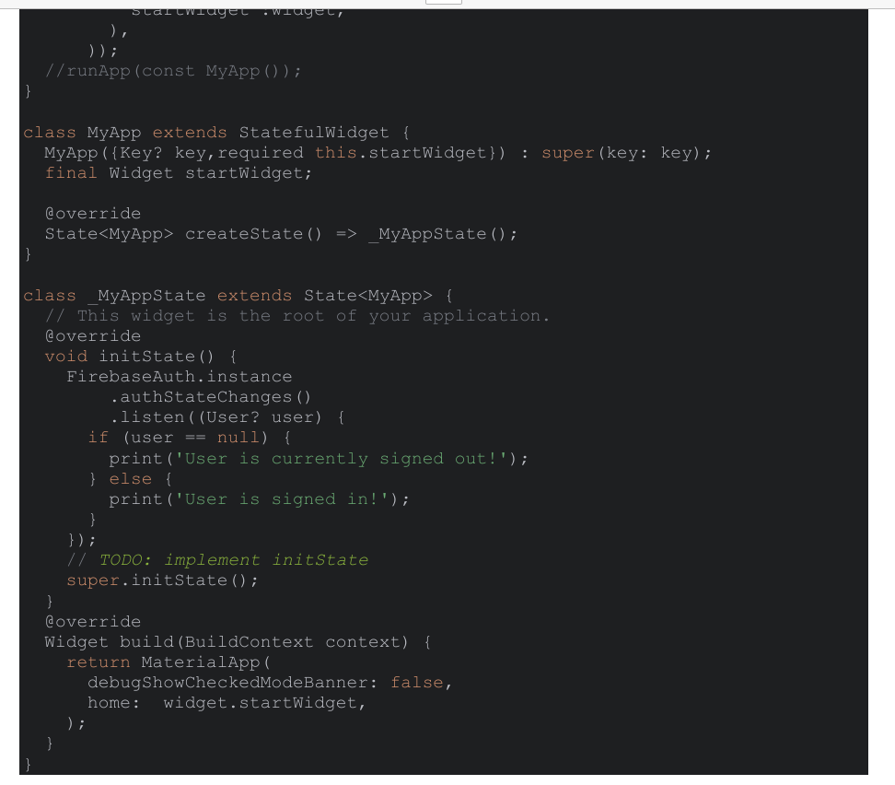
Software Implementation Cont ..
Snipped Shot of Code
Snipped Shot of Code

Slide 34
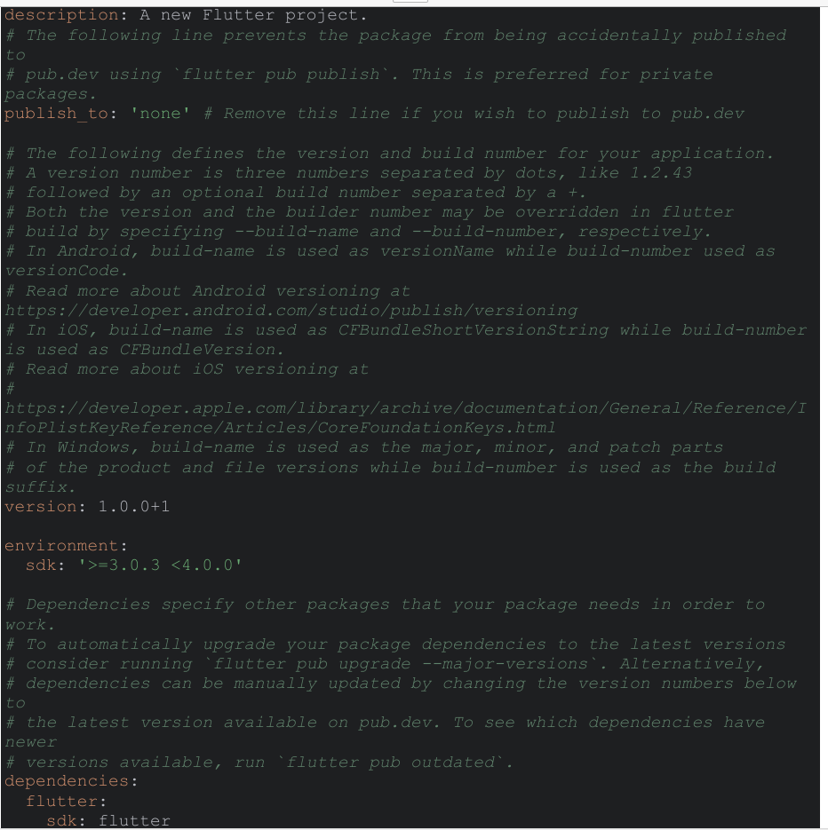
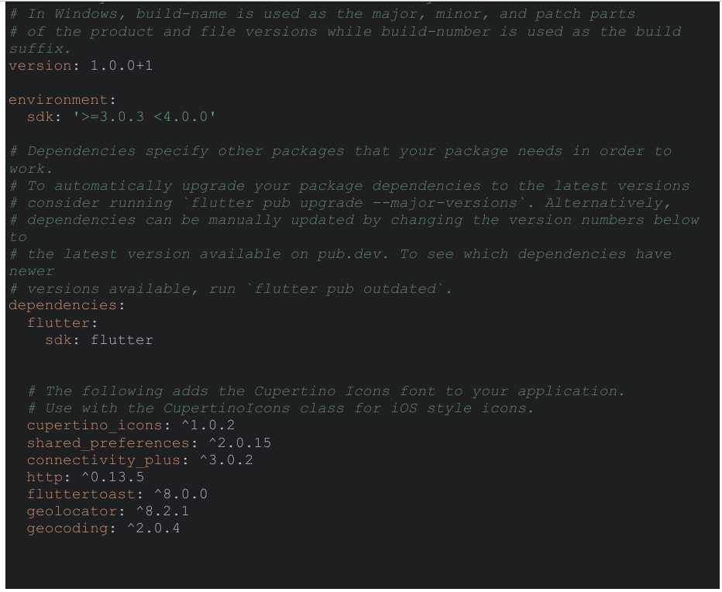
Software Implementation Cont ..
Snipped Shot of Code
Snipped Shot of Code

Slide 35
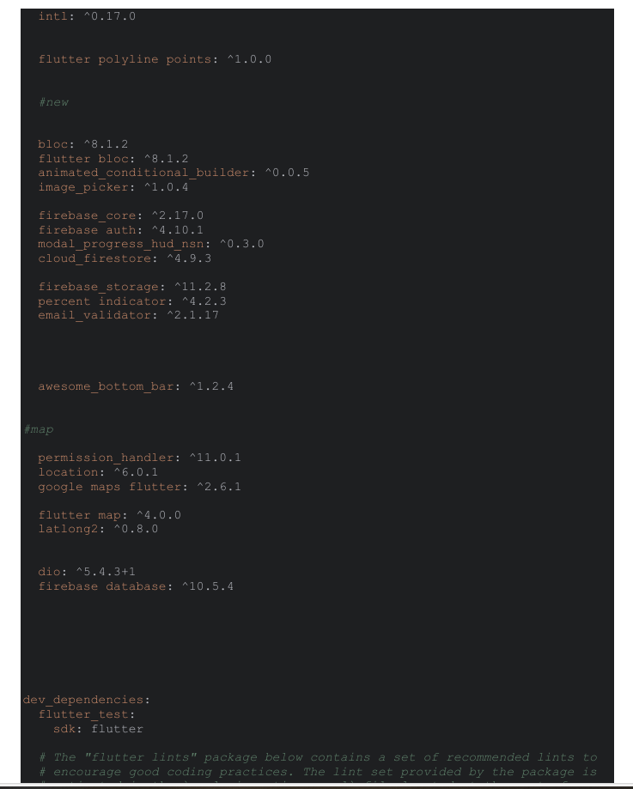
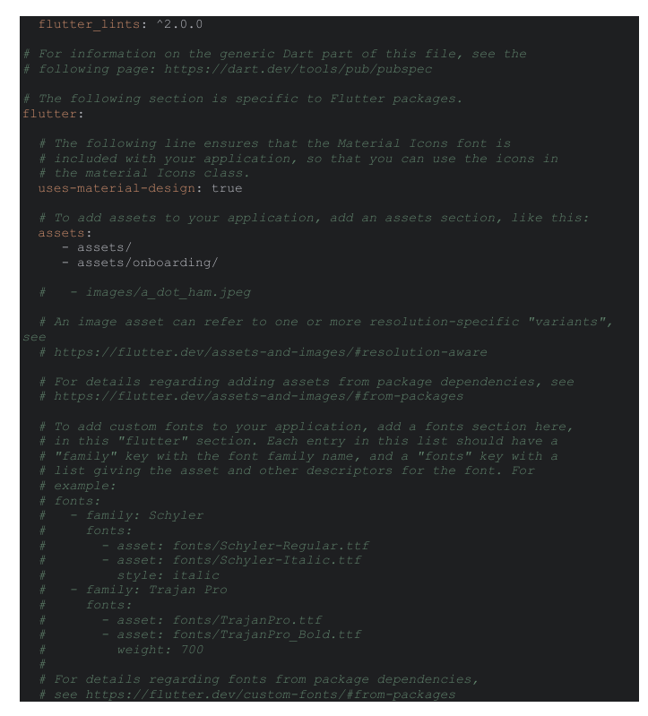
Software Implementation Cont ..
Snipped Shot of Code
Snipped Shot of Code

Slide 36
Semantic Segmentation Model Code

Slide 37
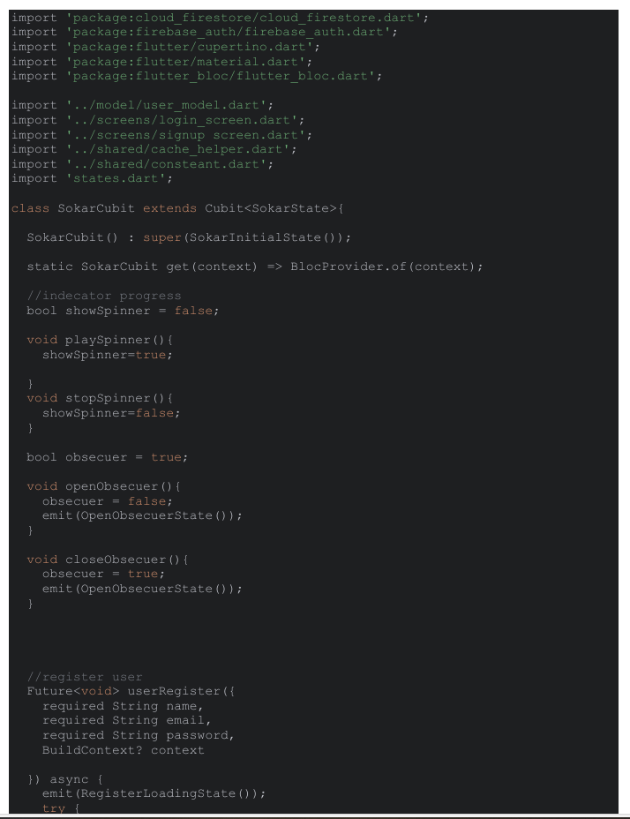
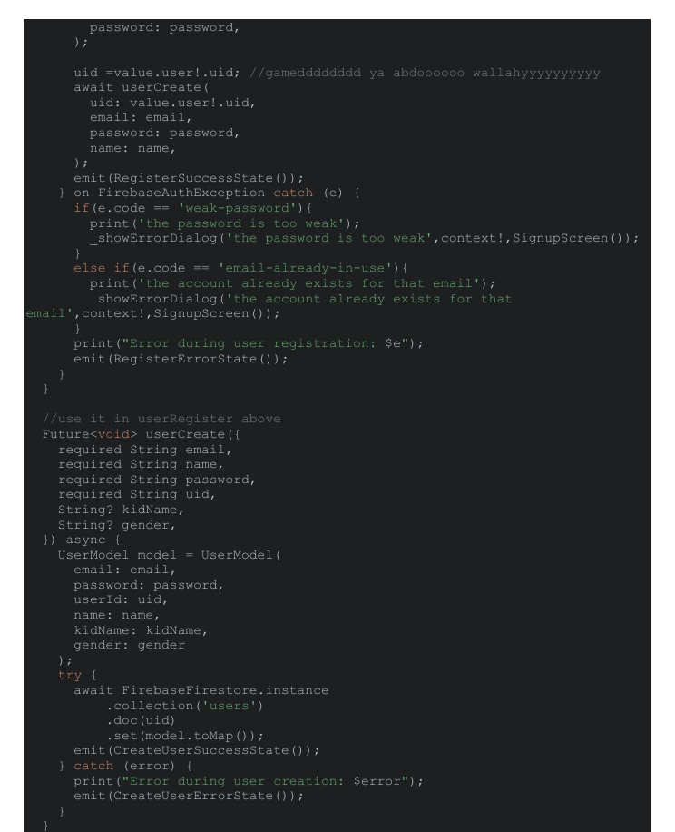
Software Implementation Cont ..
Snipped Shot of Code
Snipped Shot of Code

Slide 38
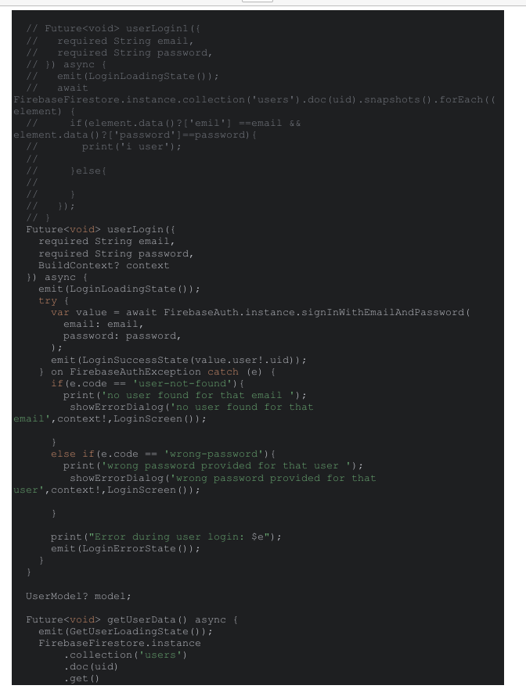
Software Implementation Cont ..
Snipped Shot of Code
Snipped Shot of Code

Slide 39
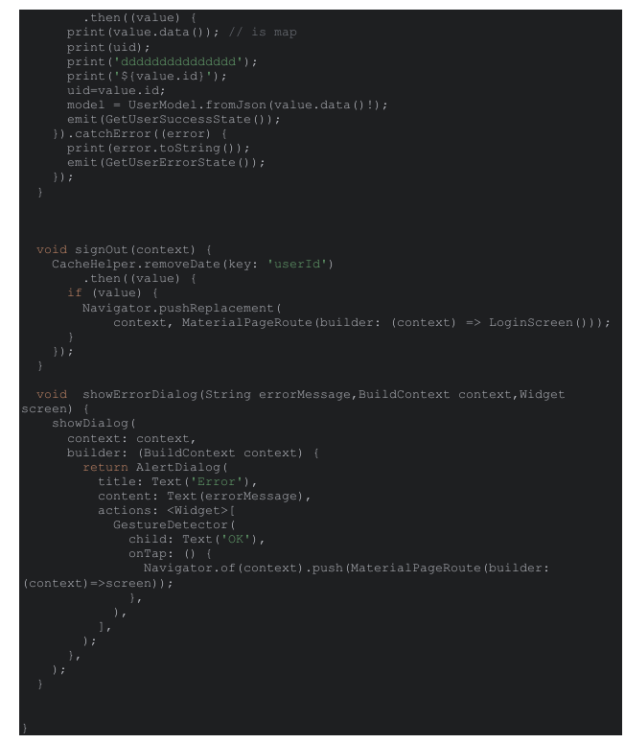
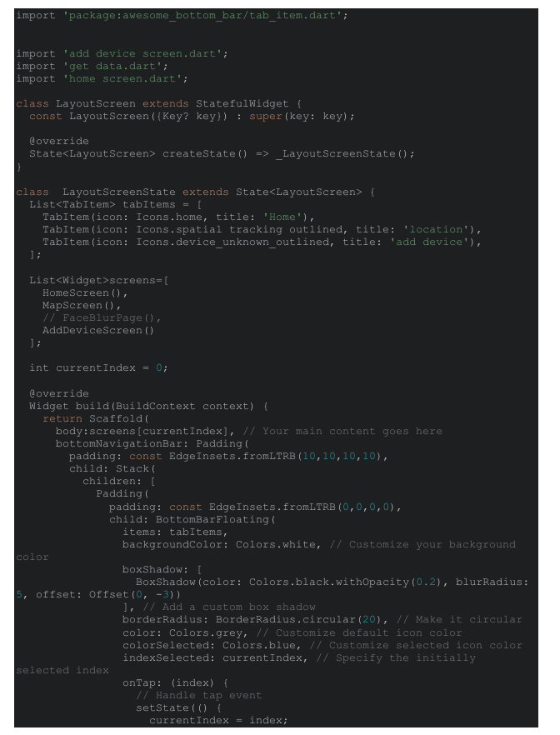
Software Implementation Cont ..
Snipped Shot of Code
Snipped Shot of Code

Slide 40
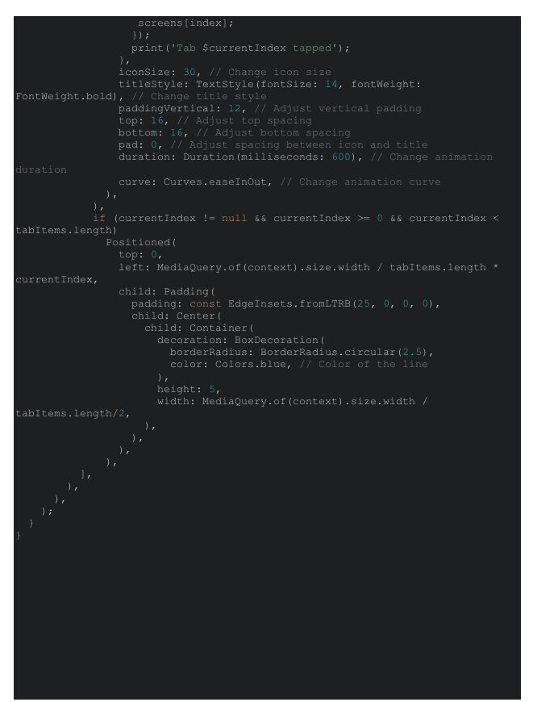
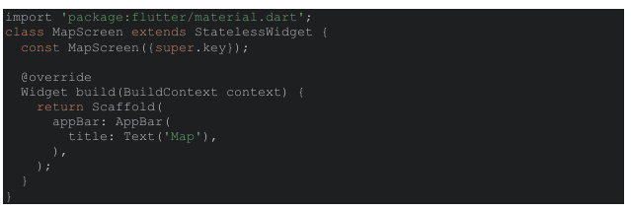
Software Implementation Cont ..
Snipped Shot of Code
Snipped Shot of Code

Slide 41
Experimental Results

Slide 42
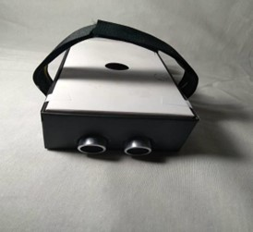
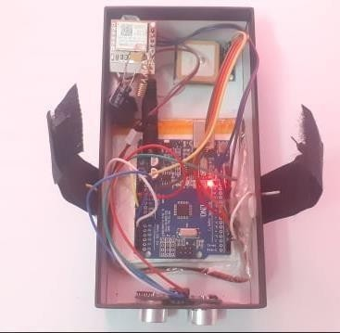
Object Detection Model Output
Tracker device
Tracker device

Slide 43
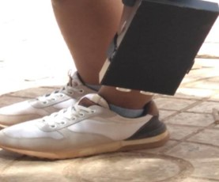

Object Detection Model Output

Slide 44
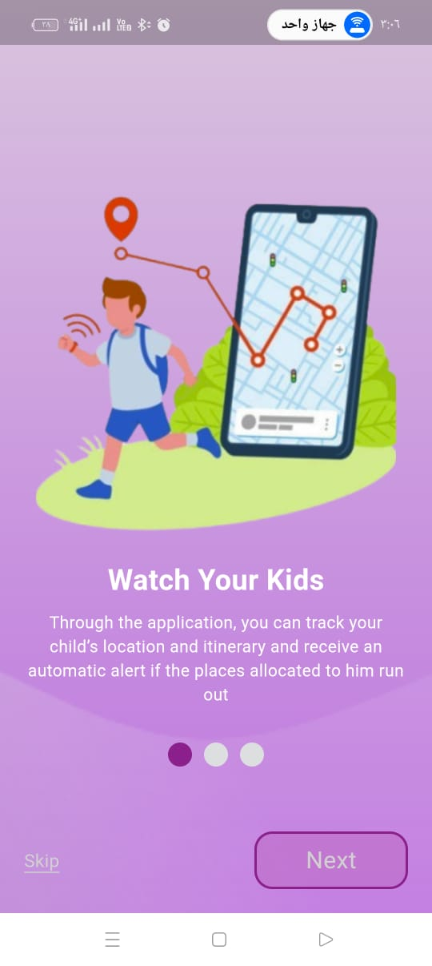
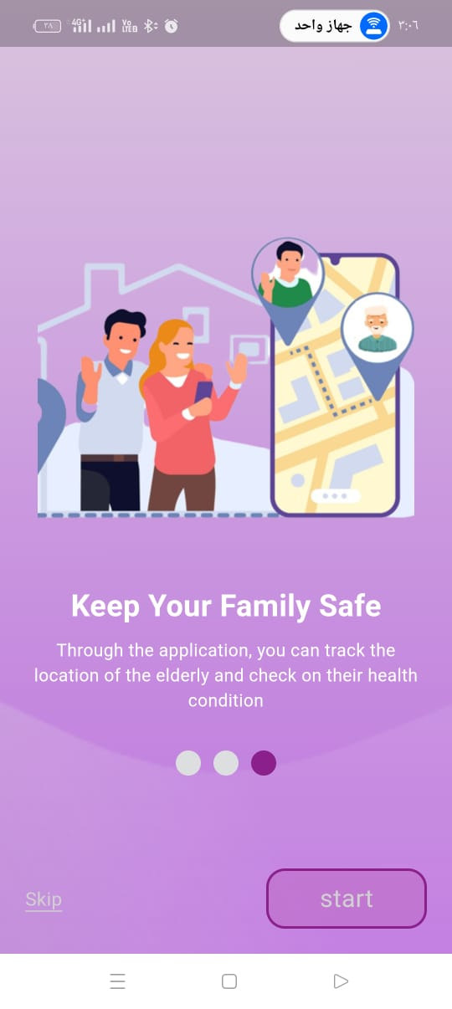
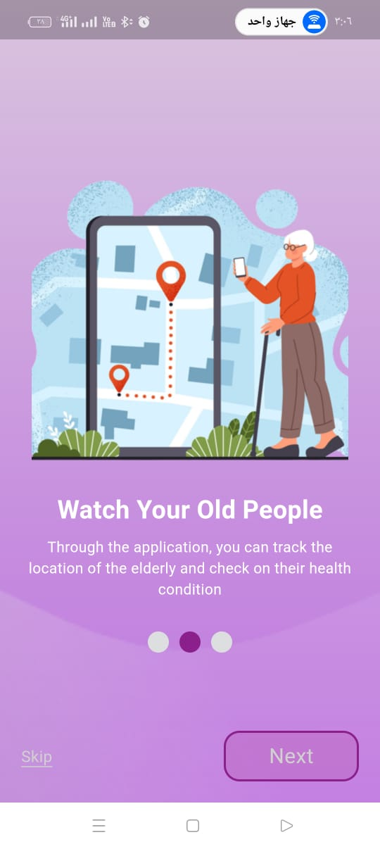
Mobile Application
Step 1 : Definition of application

Slide 45
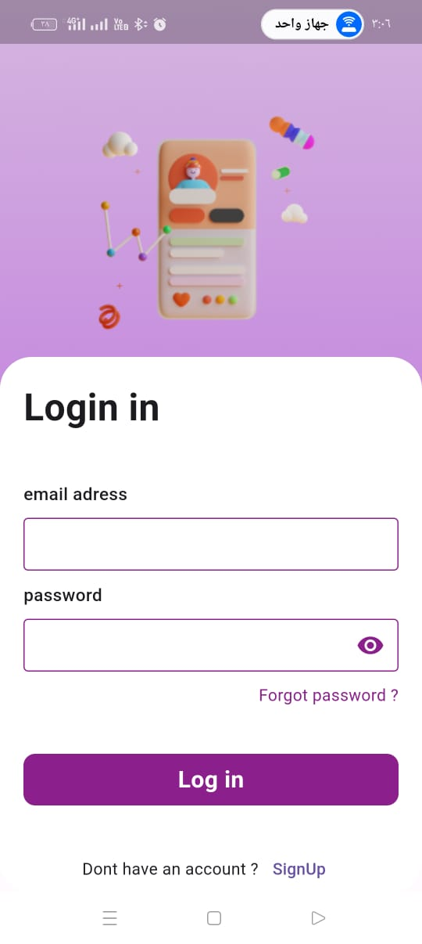
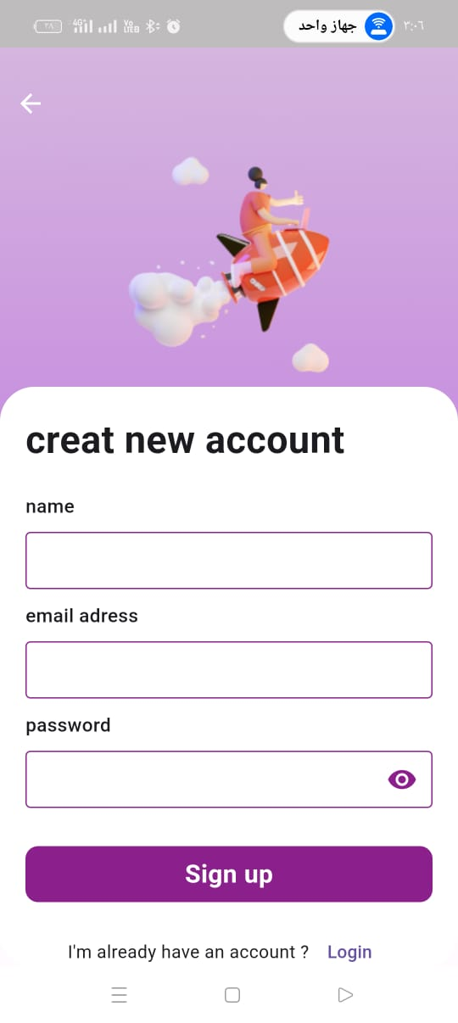
Mobile Application
Step 2 : 2 options appear
1: Page to login in
2 : page to sign in

Slide 46
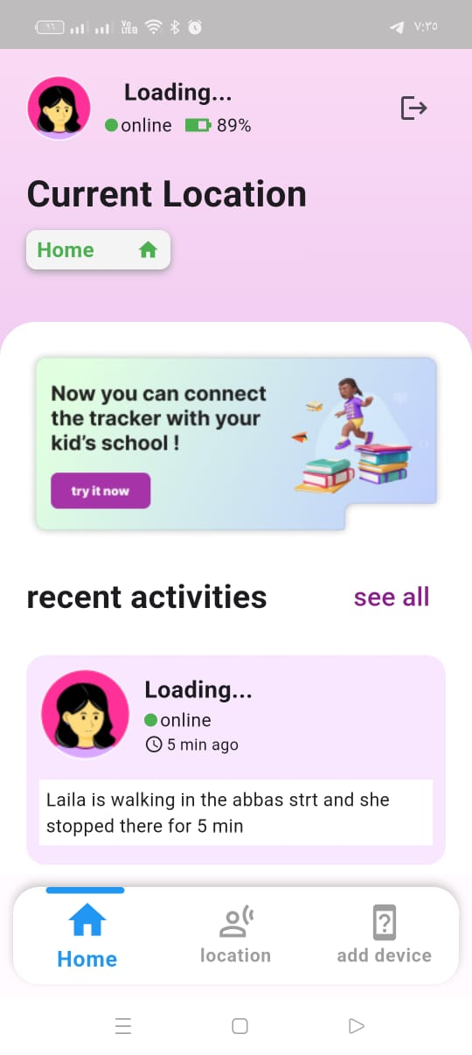
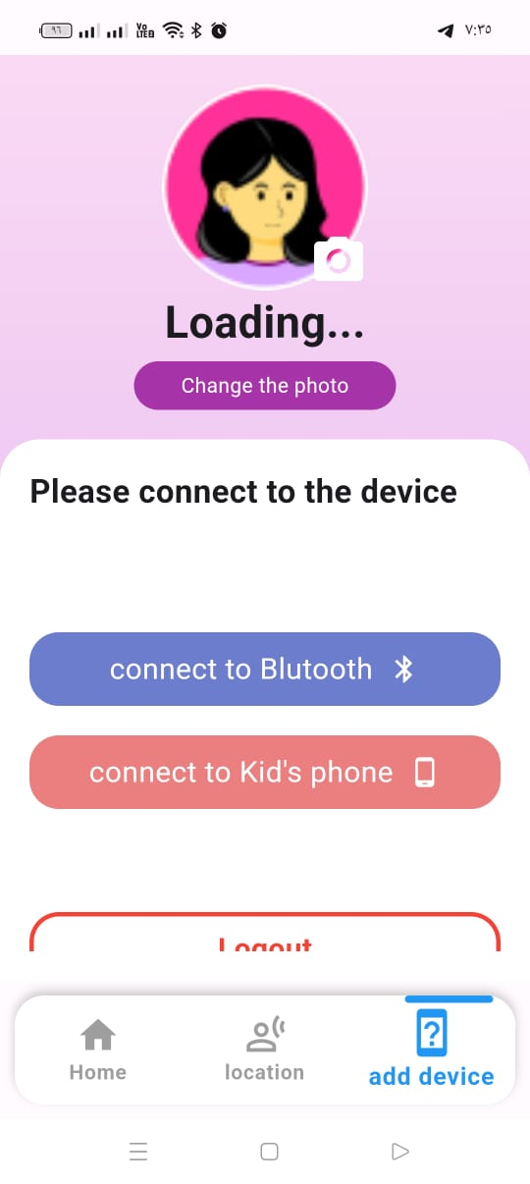
Mobile Application
Step 3 :
Step 4 :
A page to choose connection methods if via Bluetooth or kid’s phone
A page containing the person’s data

Slide 47
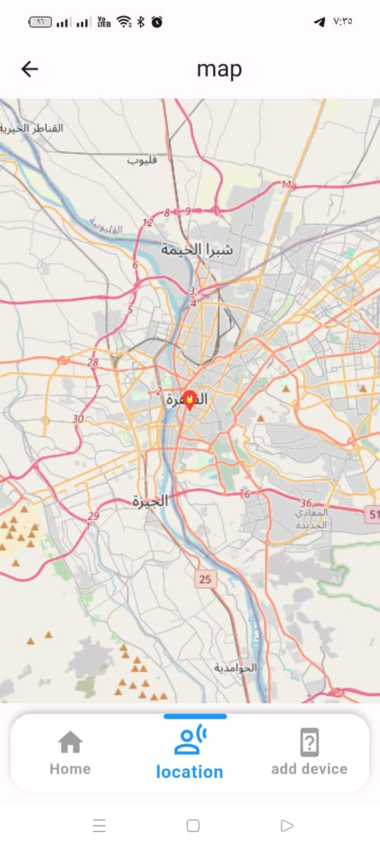
Mobile Application
Step 5 : A page appears for the location of the person you are following

Slide 48
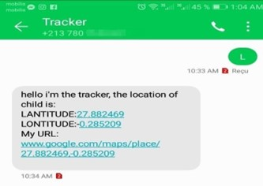
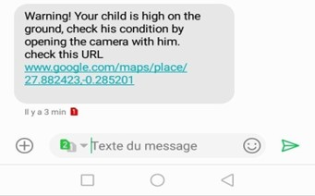
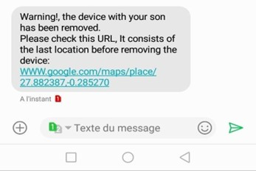
Mobile Application
Send SMS “L” to make the location of the child
Alarm SMS, when the child is carried
Alarm SMS, when the tracker is device removed

Slide 49

Thank You
Any Questions?

